Slide 1





WiDir: A Wireless-Enabled Directory Cache Coherence Protocol
Antonio Franques¹ (franque2@illinois.edu),
Apostolos Kokolis¹, Sergi Abadal², Vimuth Fernando¹, Sasa Misailovic¹, Josep Torrellas¹
¹University of Illinois at Urbana-Champaign
² Universitat Politècnica de Catalunya
CCF-1629431
863337 (WiPLASH)
Notes:
Hello, my name is Antonio Franques and today I will be presenting WiDir: A Wireless-Enabled Directory Cache Coherence Protocol. This work has ben done in collaboration with my colleagues at the university of Illinois at urbana-champaign and universitat politecnica de catalunya

Slide 2
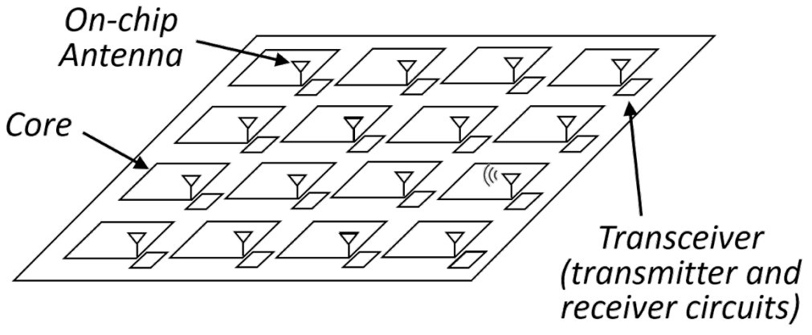
Context
Current trends are leading to larger manycores
Wireless on-chip communication holds promise for the implementation of fast networks for these multiprocessors
In complement of a wired NoC, wireless provides
Low latency
Natural broadcast capabilities
Flexibility
Notes:
The context of this work arises from the fact that current semiconductor trends are leading to larger manycores.
Wireless on chip communication holds promise for the implementation of fast networks for these multiprocessors due to the fact that when used in complement of a wired network on chip, wireless can provide a low-latency, broadcast-friendly, and flexible environment to send data across the chip

Slide 3

Related Work: Replica^{[ASPLOS ‘19]}
On-chip wireless communication for communication-intensive data
Wireless antenna and transceiver
Core
L1
L2 (LLC)
Broadcast memory
(up to 512 KB)
Notes:
Previous works, such as Replica, already took advantage of wireless on-chip communication to handle synchronization and communication-intensive data. They augmented the already existing wired network on the chip with a per-core wireless antenna and transceiver used to broadcast messages. In that design, the data being communicated through the wireless network resides in a dedicated segment of memory, called (CLICK) the broadcast memory

Slide 4
Related Work: Replica^{[ASPLOS ‘19]}
On-chip wireless communication for communication-intensive data
Core0
…
b=1
…
Core15
…
b=1
…
Core3
…
b=1
…
Master Thread​
… barrier_wait(b)
…
Notes:
The idea behind Replica is that all broadcast memories in the chip contain the same data, and any update to the data that we allocate in it, is broadcasted across the chip in about 5 cycles. As an example, imagine a (CLICK) master thread running on Core0, and (CLICK) two worker threads running on Cores 3 and 15. In this example, the data allocated in the broadcast memory corresponds to (CLICK) barrier B.

Slide 5
Related Work: Replica^{[ASPLOS ‘19]}
On-chip wireless communication for communication-intensive data
Core0
…
b=0
…
Core15
…
b=1
…
Core3
…
b=1
…
Master Thread​
… barrier_wait(b)
…
Notes:
When the master thread arrives at the barrier, it tentatively updates its value and passes it along to the local wireless transceiver.

Slide 6
Related Work: Replica^{[ASPLOS ‘19]}
On-chip wireless communication for communication-intensive data
Core0
…
b=0
…
Core15
…
b=0
…
Core3
…
b=0
…
Master Thread​
… barrier_wait(b)
…
Notes:
The transceiver then sends a broadcast message across the chip, which updates all copies of the barrier at once.

Slide 7
Related Work: Replica^{[ASPLOS ‘19]}
Challenges:
Bounded size of the broadcast memory (BMem)
Arbitrary data structures do not fit
Need profiling tools to identify what data to put in BMem
BMem area/energy overhead (≈ size L2 cache)
BMem data is replicated to all cores
Notes:
While Replica showed that using wireless for communication-intensive data can significantly speed up applications, it also arose some challenges, (CLICK) such as the bounded size of the broadcast memory, which leads to arbitrary data structures to not fit, (CLICK) the need for programmers to run profiling tools to identify what data to put in the broadcast memory, (CLICK) the area and energy overhead of the per-core broadcast memories, which is similar to the size of the L2 cache, (CLICK) and the inefficient space usage of having the same replicated data across all cores

Slide 8
Contribution: WiDir
WiDir: a directory cache coherence protocol augmented with wireless transactions for highly shared data
2 networks (wired mesh + wireless), 1 directory
WiDir leverages per-line directory info to identify highly-shared data
WiDir uses an additional state called Wireless
Unified memory hierarchy. No BMem needed
Cache lines dynamically transition wired⟺wireless based on access pattern
Transparent to programmer
Notes:
To tackle those challenges, we propose WiDir. (CLICK) WiDir is a directory cache coherence protocol augmented with wireless transactions for highly shared data. This unifies the usage of both wired and wireless networks in a single distributed directory and protocol. (CLICK) WiDir leverages per-line directory information to identify highly-shared data, so that programmers don’t have to manually identify and tag wireless candidates anymore. (CLICK) The WiDir cache coherence protocol uses an additional state called Wireless. Because in widir we have a unified memory hierarchy we do not need broadcast memories anymore, nor need to worry about their bounded size. (CLICK) In WiDir, cache lines can dynamically transition from wired to wireless states based on the access pattern, and in a programmer-transparent manner

Slide 9
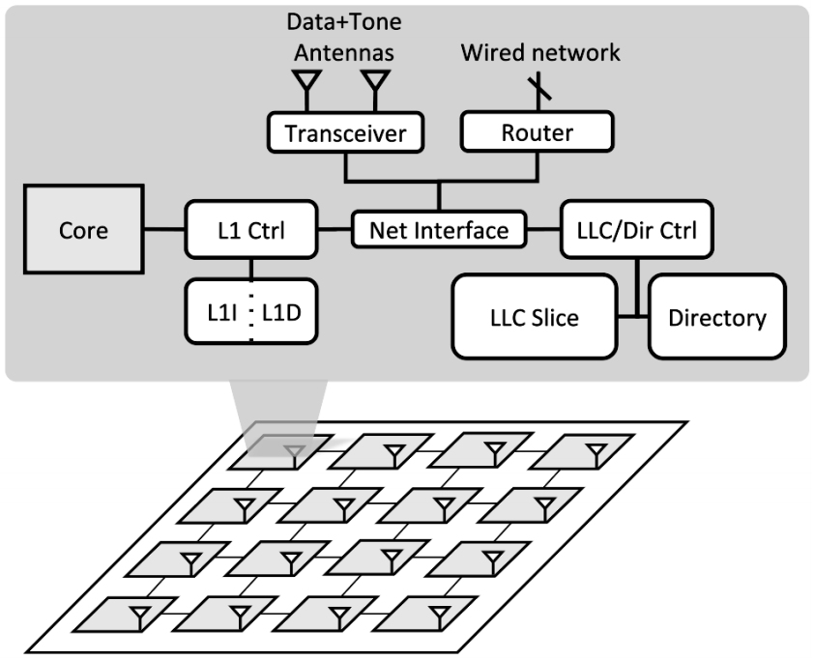
WiDir Architecture
Transceiver: modulates packet bits into wireless signals and back
Data+Tone Antennas: data channel used for data transmission; tone channel used for acknowledgement (ACK) mechanism
Notes:
The WiDir architecture augments each core with (CLICK) 2 antennas and a transceiver. These are connected to a (CLICK) network interface with access to the private L1 cache as well as to the local slice of the last-level-cache and directory. (CLICK) The transceiver is in charge of modulating packet bits into wireless signals and back, whereas the (CLICK) 2 antennas serve 2 different purposes. On the one hand, the data channel is used for data transmission, and in the other hand the tone channel is used for an acknowledgement mechanism that I will explain later.

Slide 10
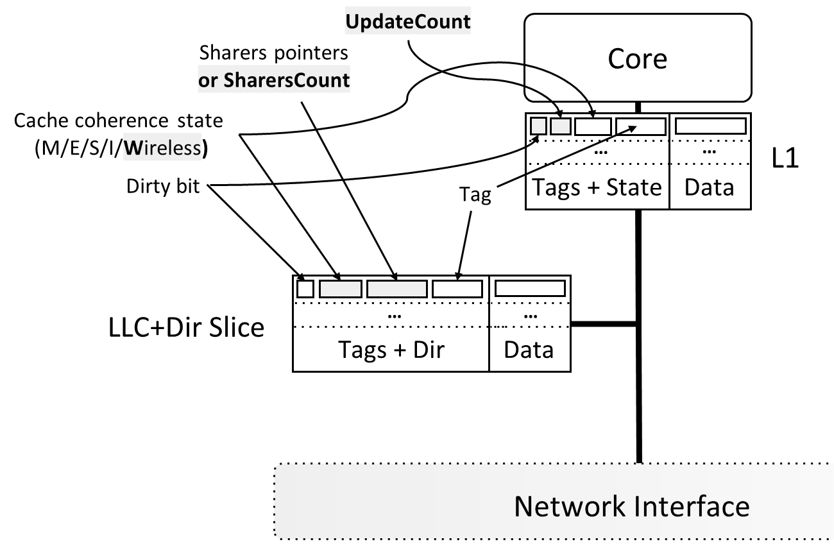
WiDir: Wireless Directory
Cache coherence state: add Wireless state
Directory pointer bits used in wired states are repurposed into number of sharers in wireless state
Add 2-bit update counter per cache line in each core to track line accesses
Notes:
The structure of the L1 cache as well as LLC+Directory in WiDir is shown in this picture. The main modifications are 1) (CLICK) that we add a cache coherence state, called Wireless. 2) (CLICK) that we repurpose the sharer pointer bits of the wired states into a counter when we are in this new wireless state (as I will explain in a second), and 3) (CLICK) that we add a 2-bit counter per line in each private cache to track accesses when we also are in this new wireless state (as I will also explain in a minute)

Slide 11
WiDir: Switching Wired⟹Wireless
Baseline problem: limited number of sharer pointers
If sharers overflow, set broadcast bit. If a write comes, invalidate everyone
WiDir solution: if sharers overflow, switch to Wireless state
Then repurpose sharers pointers into sharers counter (SharersCount) to track number of sharers for the line
Every time a node is added to wireless pool → directory increments SharersCount
If a write comes, broadcast updated word through wireless
Notes:
Because the number of sharer pointers is limited, in the baseline if we have more sharers than pointers, the directory must assume that all cores might have the line, and therefore it sets the so-called broadcast bit of the line to 1. This way if later-on a write request comes to a line that has the broadcast bit set to 1, the directory must invalidate everybody; this is a costly procedure. (CLICK) In contrast, with Widir, once the number of sharers goes above a certain value and we cannot keep any more pointers, the system changes to wireless state and the pointer bits change their purpose to count the number of sharers for the line. (CLICK) Every time a node is added to the wireless pool, the directory increments this counter. (CLICK) If a write comes, we broadcast the updated word through wireless to all other sharers

Slide 12
WiDir: Switching Wired⟸Wireless
Problem: if the line is not highly shared anymore, wireless broadcasts are counterproductive
Wireless bandwidth is limited. Contention must remain as low as possible
WiDir solution: Use update counter (UpdateCount) to track number of local accesses to wireless lines
Every time a node receives a wireless update → increments local UpdateCount
When the node accesses the line → resets UpdateCount to 0
If UpdateCount reaches threshold → cache invalidates line and notifies directory
When directory receives notification → decrements SharersCount
If SharersCount below threshold → directory broadcasts message to all sharers, and switch back to wired Shared state
Notes:
Something to also take into consideration though is that if a line is not highly shared anymore, wireless broadcasts are counterproductive, since the wireless bandwidth is limited, and contention must remain as low as possible. (CLICK) Our solution for that is to have an update counter per cache line to track the number of local accesses to wireless lines. (CLICK) This way every time a node receives a wireless update it increments the counter by 1, (CLICK) and every time the node accesses the line it resets it back to 0. (CLICK) If the counter ever reaches a certain threshold, the line is assumed to not be consumed anymore, and therefore it is invalidated locally. In this case the node notifies the directory, (CLICK) so that this one decreases the sharers counter by 1. (CLICK) If at some point the sharers counter goes below a certain threshold, it is assumed that the line is not a good candidate for wireless anymore, and a downgrade message is broadcasted to all remaining sharers, so that they all can switch back to the wired shared state.

Slide 13
Baseline: Cache Coherence Algorithm
Data
D
B
P
State
D: Dirty bit
B: Broadcast bit
P: Sharers pointers
LLC
Shared
Main Mem
x = 5
Dir
x = 5
1
3
Wired Network
Not present
Shared
L1
L1
Shared
Not present
L1
5
L1
5
Core1
Core2
Core3
Core4
Notes:
In order to illustrate the differences between widir and the baseline architecture I will now show some examples. Starting with the baseline, (CLICK) on the top of this figure we have the home directory of a given address X, and at the bottom (CLICK) we have 4 different cores. The initial state consists of the (CLICK) last-level-cache as well as cores 1 and 3 already holding a copy of X, with a value of 5, and the directory tracking both cores in its pointers, in state Shared.

Slide 14
Baseline: Sharer Pointers Overflow
Data
D
B
P
State
D: Dirty bit
B: Broadcast bit
P: Sharers pointers
LLC
Shared
Main Mem
x = 5
Dir
x = 5
1
3
Wired Network
Not present
Shared
L1
L1
Shared
Not present
L1
5
L1
5
1
Core1
Core2
Core3
Core4
Read x
Notes:
The first example I want to show you addresses what happens in the baseline if we have more sharers than pointers for a given line. In this case, imagine core 2 issues a read to address X

Slide 15
Baseline: Sharer Pointers Overflow
Data
D
B
P
State
D: Dirty bit
B: Broadcast bit
P: Sharers pointers
LLC
Shared
Main Mem
x = 5
Dir
x = 5
1
3
Wired Network
2
Not present
Shared
L1
L1
Shared
Inv→Shared
L1
5
L1
5
1
Core1
Core2
Core3
Core4
Read x
Notes:
Because the line is not present in its L1 cache, it requests it to the directory

Slide 16
Baseline: Sharer Pointers Overflow
3
Data
D
B
P
State
D: Dirty bit
B: Broadcast bit
P: Sharers pointers
LLC
Shared
Main Mem
x = 5
Dir
x = 5
1
3
Wired Network
2
Not present
Shared
L1
L1
Shared
Inv→Shared
L1
5
L1
5
1
Core1
Core2
Core3
Core4
Read x
Notes:
Now, because in this example I have assumed the directory to have 2 sharer pointers per cache line, if in the baseline a third sharer comes, the directory does not have room to track that third or any future sharer, and the pointers overflow. This is why the directory now (CLICK) sets the broadcast bit to 1, and the sharer pointers are disregarded. At the same time, the directory sends the data to the requesting cache

Slide 17
Baseline: Sharer Pointers Overflow
3
Data
D
B
P
State
D: Dirty bit
B: Broadcast bit
P: Sharers pointers
LLC
Shared
Main Mem
x = 5
Dir
x = 5
1
3
Wired Network
2
Not present
Shared
L1
L1
Shared
Shared
L1
5
L1
5
5
4
1
Core1
Core2
Core3
Core4
Read x
Notes:
Upon receiving the data, core2 considers the read to be completed.

Slide 18
Baseline: Sharer Pointers Overflow
Data
D
B
P
State
D: Dirty bit
B: Broadcast bit
P: Sharers pointers
LLC
Shared
Main Mem
Dir
What would happen now in standard MESI if a write came?
(Hint: write-invalidate)
x = 5
x = 5
1
Wired Network
Not present
Shared
L1
L1
Shared
Shared
L1
5
L1
5
5
Core1
Core2
Core3
Core4
Notes:
So what would happen now in this standard MESI baseline if a write came? Well, we would have to invalidate everybody.

Slide 19
Baseline: Write Miss
Data
D
B
P
State
D: Dirty bit
B: Broadcast bit
P: Sharers pointers
LLC
Shared
Main Mem
x = 5
Dir
x = 5
1
Wired Network
Not present
Shared
L1
L1
Shared
Shared
L1
5
L1
5
5
1
Core1
Core2
Core3
Core4
Write x
Notes:
This is precisely what is shown here, when Core4 issues a Write to addr x

Slide 20
Baseline: Write Miss
Data
D
B
P
State
D: Dirty bit
B: Broadcast bit
P: Sharers pointers
LLC
Shared
Main Mem
x = 5
Dir
x = 5
1
Wired Network
2
Inv→Modified
Shared
L1
L1
Shared
Shared
L1
5
L1
5
5
1
Core1
Core2
Core3
Core4
Write x
Notes:
Because core4 doesn’t have the line in its L1 cache, it also must request it from the directory

Slide 21
Baseline: Write Miss
3
Data
D
B
P
State
D: Dirty bit
B: Broadcast bit
P: Sharers pointers
LLC
Modified^{(Blocked)}
Main Mem
Dir
x = 5
x = 5
1
4
3
Wired Network
3
3
2
3
Inv→Modified
Shared
L1
L1
Shared
Shared
L1
5
L1
5
5
1
Core1
Core2
Core3
Core4
Write x
Notes:
The directory, upon receiving the write request, it blocks the line, it sees the broadcast bit is set to 1, so it broadcasts an (CLICK) invalidation message to everybody, it sends (CLICK) the data to the requester, it (CLICK) clears the broadcast bit, and sets Core4 as the only sharer in the pointer bits.

Slide 22
Baseline: Write Miss
Data
D
B
P
State
D: Dirty bit
B: Broadcast bit
P: Sharers pointers
LLC
Modified^{(Blocked)}
Main Mem
x = 5
Dir
x = 5
4
3
Wired Network
3
3
2
3
4
Inv→Modified
Invalid
L1
L1
Invalid
Invalid
L1
L1
5
1
Core1
Core2
Core3
Core4
Write x
Notes:
Upon receiving the invalidation request from the directory, all cores invalidate the line and send (CLICK) an invalidation acknowledgement to Core4

Slide 23
Baseline: Write Miss
Data
D
B
P
State
D: Dirty bit
B: Broadcast bit
P: Sharers pointers
LLC
Modified^{(Blocked)}
Main Mem
x = 5
Dir
x = 5
4
5
3
Wired Network
3
3
2
3
4
Modified
Invalid
L1
L1
Invalid
Invalid
L1
L1
9
1
Core1
Core2
Core3
Core4
Write x
Notes:
After core4 has received all invalidation acknowledgements it rewrites the value of x to 9, and it sends an unblock message to the directory

Slide 24
Baseline: Write Miss
6
Data
D
B
P
State
D: Dirty bit
B: Broadcast bit
P: Sharers pointers
LLC
Modified
Main Mem
Dir
x = 5
1
4
6
x = 5
5
3
Wired Network
3
3
2
3
4
Modified
Invalid
L1
L1
Invalid
Invalid
L1
L1
9
6
1
Core1
Core2
Core3
Core4
Write x
Notes:
At this point Core4’s write is completed, and the line in the directory is unblocked and marked as dirty

Slide 25
Baseline: Write Miss
Data
D
B
P
State
D: Dirty bit
B: Broadcast bit
P: Sharers pointers
Problems:
Multi-step process with high latency (especially as core count increases)
Particularly bad for producer-consumer pattern where data is frequently read/written (each write invalidates all sharers, then all suffer read miss)
Even worse if we have more sharers than pointers If pointers overflow → invalidation broadcast
LLC
Modified
Main Mem
x = 5
Dir
x = 5
4
Wired Network
Modified
Invalid
L1
L1
Invalid
Invalid
L1
L1
9
Core1
Core2
Core3
Core4
Write x
Notes:
As this example has illustrated, this is a costly multi-step process that can incur into high latencies; particularly for chips with a large core count, (CLICK) and for applications that show a producer-consumer pattern, as each write must invalidate all sharers, and force these to later suffer many costly read misses. (CLICK) This problem is exacerbated when we have more sharers than pointers for a given line, since it forces the invalidations to be broadcasted to everybody as opposed to singled out sharers.

Slide 26
Baseline: Write Miss
Data
D
B
P
State
D: Dirty bit
B: Broadcast bit
P: Sharers pointers
Solution (WiDir):
Update all sharers of a wireless line upon a write
No more read-misses after each write
Use wireless to broadcast word updates
Single hop regardless of core count
LLC
Modified
Main Mem
x = 5
Dir
x = 5
4
Wired Network
Modified
Invalid
L1
L1
Invalid
Invalid
L1
L1
9
Core1
Core2
Core3
Core4
Write x
Notes:
Widir solves this problem by updating all sharers of a wireless line upon a write, as opposed to invalidating them. This means that sharers of a line in wireless state do not suffer read misses after each write, (CLICK) but instead use the wireless medium to broadcast their word updates in a few cycles and a single hop regardless of the core count

Slide 27
WiDir: Cache Coherence Algorithm
Data
D
P/C
State
D: Dirty bit
P: Sharers pointers
C: Sharers counter
LLC
Shared
Main Mem
x = 5
Dir
x = 5
1
3
Wired Network
Not present
Shared
L1
L1
Shared
Not present
L1
5
L1
5
Core1
Core2
Core3
Core4
Notes:
To show how the same situation that we saw before for the baseline looks like in widir, we have added (CLICK) one antenna to the directory and to each core. Similarly as in the baseline, the initial state consists of the (CLICK) last-level-cache as well as cores 1 and 3 already holding a copy of X, with a value of 5, and the directory tracking both cores in its pointers, in state Shared. Notice that in widir the broadcast bit is never used, and therefore we removed it from the diagram.

Slide 28
WiDir: Write Miss + Switch to Wireless
Data
D
P/C
State
D: Dirty bit
P: Sharers pointers
C: Sharers counter
LLC
Shared
Main Mem
x = 5
Dir
x = 5
1
3
Wired Network
Not present
Shared
L1
L1
Shared
Not present
L1
5
L1
5
1
Core1
Core2
Core3
Core4
Write x
Notes:
So, to follow the same example as in the baseline, we show how widir works when Core4 issues a Write to address x.

Slide 29
WiDir: Write Miss + Switch to Wireless
Data
D
P/C
State
D: Dirty bit
P: Sharers pointers
C: Sharers counter
LLC
Shared
Main Mem
x = 5
Dir
x = 5
1
3
Wired Network
2
Inv→Modified
Shared
L1
L1
Shared
Not present
L1
5
L1
5
1
Core1
Core2
Core3
Core4
Write x
Notes:
Similarly as in the baseline example, core4 doesn’t have the line in its L1 cache, so it sends a message to the directory requesting a copy of the line

Slide 30



WiDir: Write Miss + Switch to Wireless
Data
D
P/C
State
3
D: Dirty bit
P: Sharers pointers
C: Sharers counter
3
3
3
LLC
Shared→Wireless
3
Main Mem
x = 5
Dir
x = 5
1
3
How does the directory know all cores received and processed a wireless upgrade request?
We need a fast mechanism to obtain acknowledgements in wireless!
3
Wired Network
2
Inv→Modified
Shared
L1
L1
Shared
Not present
L1
5
L1
5
1
Core1
Core2
Core3
Core4
Write x
Notes:
This time however, because in widir when we have more sharers than pointers we trigger a switch to wireless state, (CLICK) the directory broadcasts a wireless_upgrade message via wireless to everybody. It also blocks the line with a wireless jamming mechanism that I will explain later, and at the same time sends the line to the new sharer through the wired network. (CLICK) The question though is, how does the directory know when all cores have received the wireless upgrade request, and moved to wireless state if it happens via wireless? We need a fast mechanism to obtain acknowledgements

Slide 31
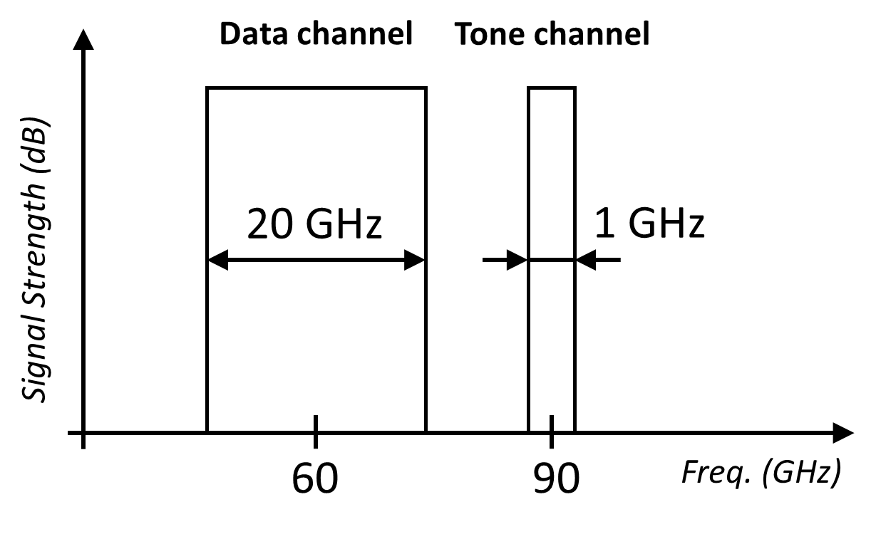
WiDir: Wireless Channels
Notes:
That is why in widir we have 2 antennas operating at 2 different frequencies or channels. While we use the (CLICK) data channel at 60 GHz to transmit word updates, we use (CLICK) a narrow-band tone channel at 90 GHz for our acknowledgement mechanism

Slide 32
WiDir: Tone Channel
STEP 1: A node broadcasts a message through data channel that requires acknowledgement from everybody
= Triggering node
= Node with tone OFF
= Node with tone ON
Notes:
This acknowledgment mechanism consists of the following. Imagine we have a certain node that wants to get an ACK from everybody. This node, which is depicted in gray, starts by (CLICK) broadcasting a message through the data wireless channel to everybody

Slide 33
WiDir: Tone Channel
STEP 2: The message triggers all remote nodes to turn their tone channel ON
= Triggering node
= Node with tone OFF
= Node with tone ON
Notes:
Upon receiving that message, all remote transceivers automatically (CLICK) turn their tone channel ON, as depicted by the nodes in blue.

Slide 34
WiDir: Tone Channel
STEP 3: After a node has finished processing the message, it turns its tone channel OFF
= Triggering node
= Node with tone OFF
= Node with tone ON
Notes:
After each node has finished processing the message, (CLICK) it turns its tone channel off, as depicted by the nodes in white

Slide 35
WiDir: Tone Channel
STEP 4: When triggering node doesn’t sense any energy in the tone channel, it knows everyone processed message
= Triggering node
= Node with tone OFF
= Node with tone ON
Notes:
Finally, when the triggering node doesn’t sense any energy in the tone channel anymore, it knows everyone has finished processing the message

Slide 36
WiDir: Tone Channel
STEP 4: When triggering node doesn’t sense any energy in the tone channel, it knows everyone processed message
Acts as a collective binary OR (‘0’ for all silent, ‘1’ for someone transmitting)
Inexpensive ACK mechanism
Great scalability. It works for any core count
= Triggering node
= Node with tone OFF
= Node with tone ON
Notes:
This tone channel thus acts as a collective binary OR operation, which provides an inexpensive ack mechanism with great scalability.

Slide 37
WiDir: Write Miss + Switch to Wireless
Data
D
P/C
State
3
D: Dirty bit
P: Sharers pointers
C: Sharers counter
3
3
3
LLC
Shared→Wireless
3
Main Mem
x = 5
Dir
x = 5
1
3
3
Wired Network
2
Inv→Modified
Shared
L1
L1
Shared
Not present
L1
5
L1
5
1
Core1
Core2
Core3
Core4
Write x
Notes:
So, now that we know how in widir we use the tone channel as an acknowledgement mechanism, we proceed with our example. As we left it off, the directory had just (CLICK) broadcasted a wireless upgrade to everybody, and also sent the line via wired network to the requester

Slide 38
WiDir: Write Miss + Switch to Wireless
Data
D
P/C
State
D: Dirty bit
P: Sharers pointers
C: Sharers counter
LLC
Shared→Wireless
Main Mem
x = 5
Dir
x = 5
1
3
3
Wired Network
2
4
4
4
4
Inv→Modified
Shared
L1
L1
Shared
Not present
L1
5
L1
5
1
Core1
Core2
Core3
Core4
Write x
Notes:
So, in the next step, we see how upon receiving that wireless upgrade message, all transceivers (except the directory, which is the triggering node) (CLICK) automatically turn their tone channel ON

Slide 39
WiDir: Write Miss + Switch to Wireless
Data
D
P/C
State
D: Dirty bit
P: Sharers pointers
C: Sharers counter
LLC
Shared→Wireless
Main Mem
x = 5
Dir
x = 5
1
3
3
Wired Network
2
5
5
5
4
Inv→Modified
Wireless
L1
L1
Wireless
Not present
L1
5
L1
5
1
Core1
Core2
Core3
Core4
Write x
Notes:
As each transceiver processes the message and moves to wireless state, or simply discards the message (as core 2 does), it turns its tone channel OFF

Slide 40
WiDir: Write Miss + Switch to Wireless
Data
D
P/C
State
D: Dirty bit
P: Sharers pointers
C: Sharers counter
LLC
Shared→Wireless
Main Mem
x = 5
Dir
x = 5
1
3
3
Wired Network
2
5
5
5
6
Wireless
Wireless
L1
L1
Wireless
Not present
L1
5
L1
5
5
1
Core1
Core2
Core3
Core4
Write x
Notes:
Eventually, the requester receives the line (via wired), places it to its L1 cache, and switches OFF its tone channel

Slide 41
WiDir: Write Miss + Switch to Wireless
7
Data
D
P/C
State
D: Dirty bit
P: Sharers pointers
C: Sharers counter
LLC
Wireless
Main Mem
Dir
x = 5
3
7
x = 5
3
Wired Network
2
5
5
5
6
Wireless
Wireless
L1
L1
Wireless
Not present
L1
5
L1
5
5
1
Core1
Core2
Core3
Core4
Write x
Notes:
This leads to the directory seeing that all tones are OFF, so it unblocks the line, it sets the sharer counter to 3, and the coherence state to Wireless

Slide 42
WiDir: Writing to a Wireless Line
Data
D
P/C
State
D: Dirty bit
P: Sharers pointers
C: Sharers counter
LLC
Wireless
Main Mem
x = 5
Dir
x = 5
3
Wired Network
1
Wireless
Wireless
L1
L1
Wireless
Not present
L1
5
L1
5
5
Core1
Core2
Core3
Core4
Write x
Notes:
At this point core4 has gotten the line in its cache, but it has not completed its write yet. For that the transceiver of Core4 attempts to broadcast the new value of the line by (CLICK) broadcasting first the header of the update message

Slide 43
WiDir: Writing to a Wireless Line
Data
D
P/C
State
D: Dirty bit
P: Sharers pointers
C: Sharers counter
LLC
Wireless
Main Mem
x = 5
Dir
x = 5
3
Wired Network
2
Wireless
Wireless
L1
L1
Wireless
Not present
L1
5
L1
5
5
Core1
Core2
Core3
Core4
Write x
Notes:
If core4 does not detect any collision at this point, (CLICK) it proceeds sending the rest of the data

Slide 44
WiDir: Writing to a Wireless Line
Data
D
P/C
State
D: Dirty bit
P: Sharers pointers
C: Sharers counter
3
LLC
Wireless
Main Mem
x = 9
Dir
x = 5
1
3
Wired Network
3
3
3
Wireless
Wireless
L1
L1
Wireless
Not present
L1
9
L1
9
9
Core1
Core2
Core3
Core4
Write x
Notes:
Upon receiving the wireless update message, all sharing caches (including Core4’s and the LLC) modify the entry with the updated word, and the directory sets the line as dirty with respect to the main memory. Since Core2 doesn’t have the line, it simply discards the update message

Slide 45
WiDir: Adding a New Sharer
Data
D
P/C
State
D: Dirty bit
P: Sharers pointers
C: Sharers counter
LLC
Wireless
Main Mem
x = 9
Dir
x = 5
1
3
Wired Network
Wireless
Wireless
L1
L1
Wireless
Not present
L1
9
L1
9
9
1
Core1
Core2
Core3
Core4
Read x
Notes:
To finalize this set of illustrative examples, we show what happens when a new sharer requests a line that is already in wireless mode. To that end we start by having Core2 issuing a Read to address x

Slide 46
WiDir: Adding a New Sharer
Data
D
P/C
State
D: Dirty bit
P: Sharers pointers
C: Sharers counter
LLC
Wireless
Main Mem
x = 9
Dir
x = 5
1
3
Wired Network
2
Wireless
Wireless
L1
L1
Wireless
Inv→Shared
L1
9
L1
9
9
1
Core1
Core2
Core3
Core4
Read x
Notes:
Because this core does not have the line, it requests it to its home directory, as usual via the wired network

Slide 47

WiDir: Adding a New Sharer
Data
D
P/C
State
3
D: Dirty bit
P: Sharers pointers
C: Sharers counter
LLC
Wireless^{(Blocked)}
Main Mem
x = 9
Dir
x = 5
1
3
3
Wired Network
3
2
3
3
3
Wireless
Wireless
L1
L1
Wireless
Inv→Shared
L1
9
L1
9
9
1
Core1
Core2
Core3
Core4
Read x
Notes:
However, because the directory sees that the requested line is already in wireless mode, it must prevent all other sharers from updating the line via wireless while the directory sends the line via wired to the requester. That is why the directory first blocks the line with the (CLICK) wireless jamming mechanism, and then sends it to the new sharer, core 2, via wired

Slide 48
WiDir: Adding a New Sharer
Data
D
P/C
State
3
D: Dirty bit
P: Sharers pointers
C: Sharers counter
LLC
Wireless^{(Blocked)}
Main Mem
x = 9
Dir
x = 5
1
3
3
Wired Network
2
4
3
3
3
3
Wireless
Wireless
L1
L1
Wireless
Wireless
L1
9
L1
9
9
9
1
Core1
Core2
Core3
Core4
Read x
Notes:
Upon receiving the line via wired, Core2 places it in its cache, and sends an acknowledgment to the directory via wired

Slide 49
WiDir: Adding a New Sharer
4
Data
D
P/C
State
D: Dirty bit
P: Sharers pointers
C: Sharers counter
LLC
Wireless
Main Mem
x = 9
Dir
x = 5
1
4
3
Wired Network
2
4
Wireless
Wireless
L1
L1
Wireless
Wireless
L1
9
L1
9
9
9
1
Core1
Core2
Core3
Core4
Read x
Notes:
Upon receiving the acknowledgement via wired, the directory increases the sharers counter by 1, and stops the jamming mechanism, effectively unblocking the line to future accesses, and considering the operation completed

Slide 50
WiDir: Wireless Jamming Mechanism
How can the directory prevent everyone from updating the line?
Option 1: By sending noise non-stop in the data channel
It is simple to implement
Uses a lot of energy
Prevents other non-blocked wireless lines from being updated
Notes:
As I hinted already, the aforementioned wireless jamming mechanism is used whenever the directory wants to prevent everyone from updating a wireless line. The equivalent to this in conventional protocols is that the directory would bounce (or buffer) requests. But now in wireless it’s different. So, how can the directory prevent everybody from updating this line? (CLICK) Option 1 would be to send noise non-stop in the data channel. (CLICK) Although this would be simple to implement, this would not be a good solution, (CLICK) as it would use a lot of energy and it would prevent other non-blocked wireless lines from being updated

Slide 51
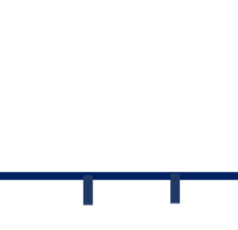
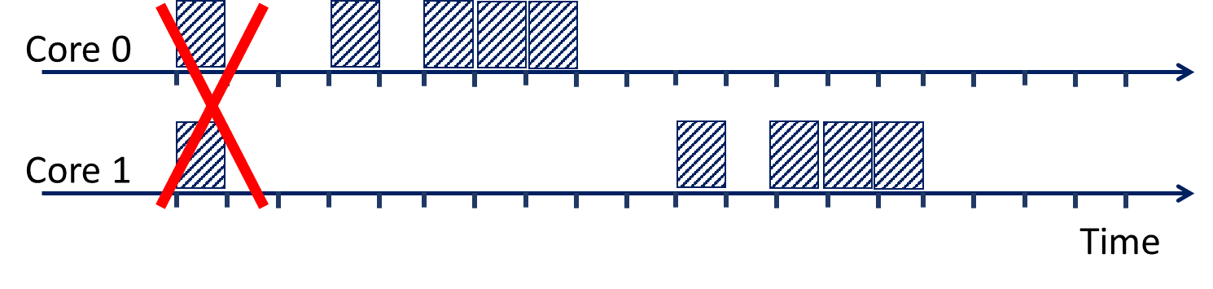
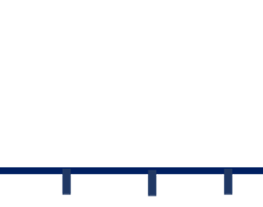
Background: Medium Access Control
Background: Medium access control (MAC) protocol forces all transmissions to leave idle cycle between header and payload
If any core detects a collision after the header, it broadcasts a NACK (negative-ACK) to report it
The cores who were transmitting stop transmission and retry later
H
H
H
message
H
message
Notes:
A better option, as we use in widir, is to leverage the medium access control (or MAC) protocol. As a background, the MAC protocol forces all transmissions to leave an idle cycle between the broadcasting of the header and the payload of a message. This is because if as shown in this example, (CLICK) two or more cores (in this case core0 and core1) transmit their header (indicated with an H) at the same time, the other nodes use the idle cycle left right after that header to broadcast a negative-acknowledgement and report the collision. In that case, the cores who were transmitting (core0 and core1) stop the transmission and retry later. In this example, (CLICK) Core0 successfully retries it first, (CLICK) and Core1 second.

Slide 52
WiDir: Wireless Jamming Mechanism
How can the directory prevent everyone from updating the line?
Option 2: By leveraging the collision mechanism of the MAC protocol
Directory checks if (partial) address in header is a multiple of a blocked line
If so, broadcast NACK, effectively jamming the update
Only jams blocked lines
Partial address matching could lead to false positives, but it is much better than blocking ALL lines
Notes:
So, in Widir whenever the directory needs to block a wireless line, if it sees the header of a sharer attempting to broadcast a write update, it checks if the address in the header partially matches that one of the blocked line, and if it does, it broadcasts a negative acknowledgement, effectively jamming the update operation. (CLICK) The good thing is that this mechanism only jams the blocked lines. (CLICK) Of course this partial address matching could lead to false positives, but it is still much better than blocking all lines

Slide 53
WiDir: Evaluation Methodology
Cycle-level architectural simulations using SST
64 out-of-order cores
Inclusive 2-level cache
2D mesh wired network (1 cycle/hop) + wireless network (20 Gbps)
Applications
20 benchmarks from SPLASH-3 and PARSEC suites
Multiple domain: Scientific computing, computer vision, kernels, etc.
Notes:
Moving on to the evaluation section, we implemented widir in a cycle-level architectural simulator, called SST, with up to 64 out of order cores, an inclusive 2-level cache, and a hybrid wired mesh with 1 cycle per hop, combined with a wireless network operating at 20 gbps. We obtained results from 20 benchmarks of the splash-3 and parsec suites, representing applications from multiple domains, such as scientific computing and computer vision

Slide 54
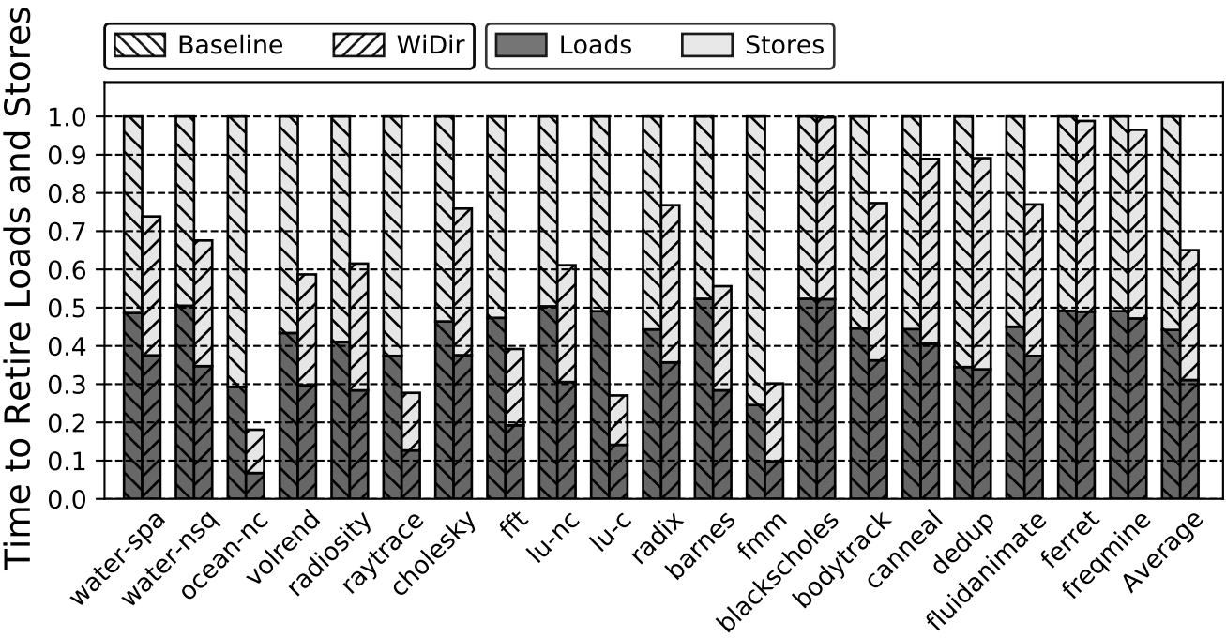
Latency of Memory Operations
WiDir reduces total latency in nearly all applications (35% on average)
Reductions are similar in both loads and stores
Notes:
First I’m going to compare the latency of memory operations in baseline and widir. The figure shows the total time to retire all the loads and all the stores for different applications. For each application we show one bar for the baseline and one for widir. The bars are broken down into the contributions of loads and stores, and they’re normalized to the baseline. Looking at different applications we see that widir reduces the total latency in nearly all the applications. On average, the reduction is 35%. We can also see that reductions are similar in both loads and stores.

Slide 55
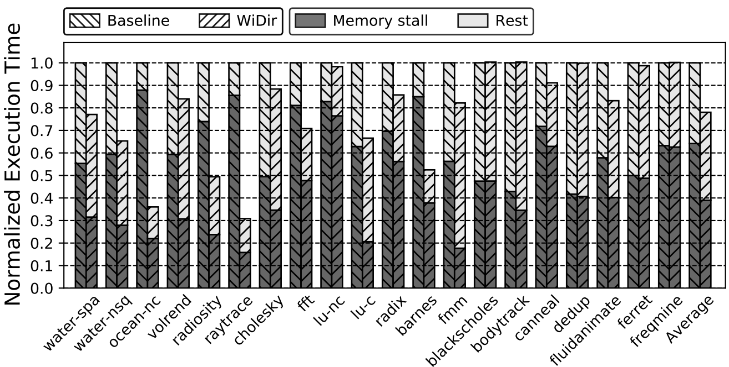
Execution Time
22%
In Baseline, many cycles are wasted to memory stalls
WiDir reduces mem stall cycles in many applications (1/3 on average)
Notes:
Now we’re going to compare the execution time in baseline and widir. The figure shows the execution time of the applications. For each application we show a bar for the baseline and one for widir. The bars are broken down into the contributions of the memory stalls, and the rest, and they’re normalized to the baseline. Looking at the applications we see that in the baseline, many cycles are wasted to memory stalls. Widir reduces these memory stalls by 1/3 on average. As a result, the average execution time on widir is reduced by 22%.

Slide 56
WiDir: Also in the Paper…
Description of all possible state transitions
Further analysis on…
Data sharing
Cache misses
Distribution of wired network hops
Power, energy and area consumption
Sensitivity of architectural parameters
Scalability
Notes:
Please refer to the paper for more details on the implementation of the widir protocol, as well as a further analysis on…

Slide 57
WiDir: Conclusions
WiDir is a directory cache coherence protocol augmented with wireless transactions for highly shared data
Leverages per-line directory information to identify highly-shared data
Uses an additional state called Wireless to update sharers upon a write
Has 2 networks (wired+wireless) and a single distributed directory
Lines dynamically transition wired⟺wireless based on access patterns
Thank you!
Presenter: Antonio Franques – franque2@illinois.edu
This presentation and recording belong to the authors. No distribution is allowed without the authors' permission.
Notes:
To conclude this presentation and to summarize, in this paper we proposed Widir. Widir is a novel directory cache coherence protocol, augmented with wireless transactions for highly shared data. (CLICK) Widir leverages per-line directory information to identify highly-shared data. (CLICK) Widir uses an additional state called Wireless to update sharers upon a write. (CLICK) Widir has 2 networks (a wired and a wireless), and a single distributed directory. (CLICK) Lines in widir dynamically transition between wired and wireless based on access patterns. (CLICK). Thank you for your attention and please do not hesitate to post any questions.

